Slide 1
Resilience Branch
Technical Assistance Division
Melissa Boudrye
Resilience Branch Chief
May 29, 2024

Slide 2
The Mission
The Resilience Branch of the California Governor’s Office of Emergency Services (Cal OES) is dedicated to fostering a resilient California by aligning mitigation planning with grant selection and implementation. Our mission is to empower communities, including those historically underserved, to compete on national and state levels for funds that enhance their resilience against natural disasters. Through innovative projects and technical assistance, we aim to reduce long-term risks, promote climate adaptation, and fortify infrastructure, fostering a state that thrives in the face of adversity.

Slide 3
Hazard Mitigation Assistance Overview

Slide 4

What is Hazard Mitigation?
Any sustained action taken to reduce or eliminate long-term risk to people and property from natural hazard events and their effects.
The long-term impact of hazard mitigation actions can be distinguished from those actions that are more closely associated with immediate preparedness, response and recovery activities, as hazard mitigation is the only emergency management phase specifically dedicated to breaking the cycle of damage, reconstruction and repeated damage.

Slide 5


Hazard Mitigation Programs
HMGP
Available after a major disaster declaration to reduce risks from natural hazards
FMA (and FMA Swift Current)
Annual, Reduces or eliminates risk of repetitive flood damage to buildings and structures insured under NFIP
HMGP Post-Fire
Prioritizes communities impacted by wildfire to mitigate fire and post-fire hazards
BRIC
Annual, nationally competitive funding for new and innovative infrastructure projects that reduce risks from natural hazards
  *Rehabilitation of High Hazard Potential Dam (HHPD) Grant Program: provides technical, planning, design, and construction assistance in the form of grants for rehabilitation of eligible high hazard potential dam in jurisdictions that address dam hazards in their LHMPs (managed by DWR)

Slide 6
Eligible Activities
Planning Grants: deliverable is a FEMA-approved LHMP (new or update)
Planning-related activity grants aim to integrate LHMPs to other planning mechanisms, outreach/education for your LHMP or floodplain management
Project scoping should be used when the mitigation problem and solution are not known, and you need to evaluate a potential intervention (i.e. the proposed activity results in a resource, strategy, or tangible mitigation product that will reduce or eliminate risk and damage from future flooding and increase resilience)
Construction projects: structural mitigation (A/D, elevation, reconstruction), drainage improvements, flood control, nature-based solutions.
Nature-based solutions include, but are not limited to, restoration of grasslands, rivers, floodplains, wetlands, dunes, and reefs; living shorelines; soil stabilization; aquiver storage and recovery; bioretention systems

Slide 7
Who’s Eligible?
  State Agencies
  Local Governments: Counties, Cities, Towns, etc.
  Special Districts
  Federally Recognized Tribes
  Private Nonprofit Organizations (PNPs) (not eligible for BRIC/FMA)
The entity must have a FEMA-approved and locally adopted LHMP
  PNPs in HMGP are exempt from this requirement

Slide 8
Submitting a Subgrant-Cal OES Process
Request a Project Scoping Call
Submit a Notice of Interest (NOI) – accepted anytime, priority given to subapplicants who submit by deadlines
NOI reviewed by Cal OES, subapplicants with eligible activities will be invited to attend a subapplication development webinar/workshops
Subapplication submitted to Cal OES
Cal OES reviews subapplications
  Request for Information (RFI)
Cal OES submits all subapplications to FEMA
  FEMA may have additional RFIs

Slide 9
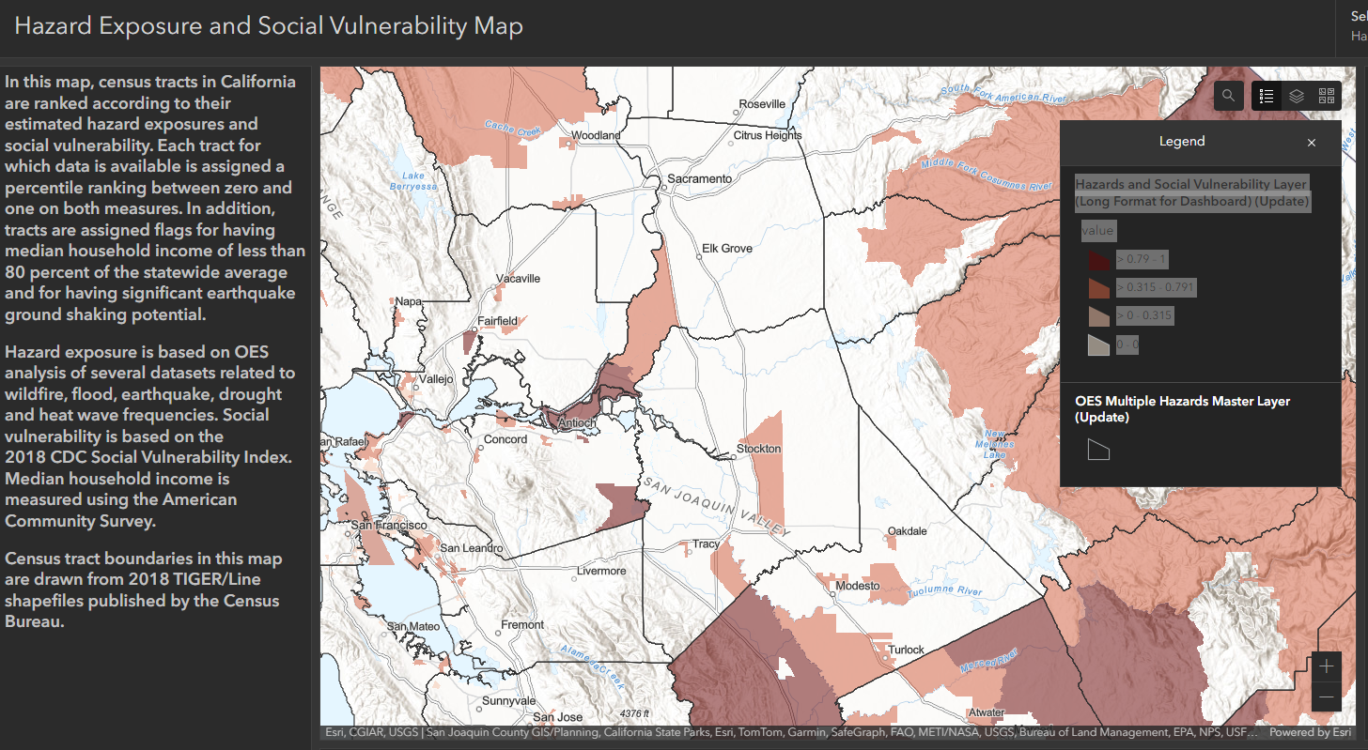
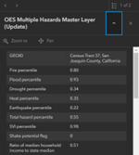
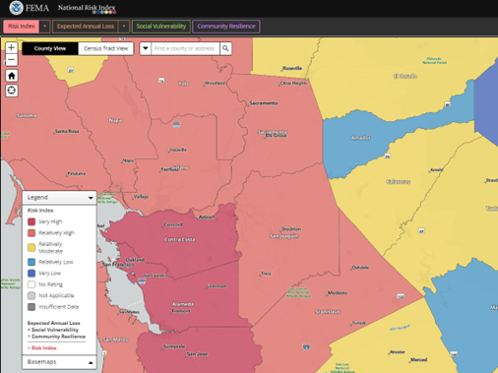
Factoring Equity into Funding Considerations
Cal OES Hazard Mitigation Assistance Division’s Vulnerability Map
FEMA’s National Risk Index (NRI)
CDC Social Vulnerability Index
Climate and Economic Justice Screening Tool (CEJST)
FEMA’s Community Disaster Resilience Zone (CDRZ) Platform
BRIC/FMA – scoring/ranking criteria incorporate equity considerations, and require communities to address how the project will directly benefit disadvantaged communities
HMGP – State scoring/ranking considerations include equity considerations (protecting a socially vulnerable community, addressing disadvantaged groups)

Slide 10
Recent HMGP funding opportunities
DR-4683 (declared 1/14/23)
  Updated 12-month lock-in on 4/1/24
  $221.8 million
DR-4699 (declared 4/3/23)
  12-month estimate 4/29/24
  $211.9 million
DR-4750 (declared 11/21/23)
  30-day estimate 1/22/24
  $16.1 million
DR-4758 (declared 2/19/2024)
  30-day estimate 4/26/24
  $9.7 million
DR-4683.4699 combined solicitation
  137 subapplications for $501 million
DR-4750 solicitation
  2/16/24 due date for NOIs
  $415 million in 99 NOIs
  DR-4758 solicitation
  5/31/24 due date for NOIs

Slide 11
Cal OES Technical Assistance
Identification of the Problem
Problem statement and history of hazards
What is the hazard and risk?
How long has it been occurring?
What are the damages and loss of function/service?
Note quantitative and qualitative losses
Future conditions (SLR, climate impacts, demographic changes, etc.)
How is climate change worsening the problem?
Potential Projects/Solutions
Include:
  Hazard Mitigation Planning
  Planning Studies
  Feasibility Studies
  Capital Project Plans
  New budgetary need requests
  Comprehensive stakeholder engagement for project identification
Do you know if the solution is feasible?
What may be the challenges with implementation?
Technical Assistance (TA)
Assistance with project scoping
How to quickly identify projects that may be eligible, feasibility, cost-effective, and competitive
Goal is to identify projects that will be competitive with FEMA’s priorities
Focus time and resources on good, fundable projects
Additional Points:
Ensure detailed Scope of Work (SoW)
  Location
  Purpose
  Approach
  Feasibility
  Expected outcomes
  Benefits of the activity
Cost estimate and narrative describing the anticipated costs
Data collection for cost-effectiveness screening
A FEMA credible Benefit Cost Analysis (BCA) is key. If the project is preliminary, phase the project and include a rerun of the BCA as a Phase I deliverable

Slide 12
Resilience Branch –
Technical Assistance Division
Cal OES established the Resilience Branch to provide enhanced technical assistance to all eligible subapplicants in the pursuit of funding for Hazard Mitigation and Resiliency Projects.
The Division houses three (3) Technical Assistance Units comprised of subject matter experts who will support in the development of a grant subapplication that is eligible, feasible, and cost effective. The team will also assist in identifying alternative funding opportunities for projects that promote resilience but may not meet the requirements of the FEMA Hazard Mitigation programs.
Climate & Flooding
Wildfire
Infrastructure
Our goal is to develop subapplications in advance of the next available funding opportunity to streamline the application process and ensure that all jurisdictions can apply for mitigation funding.

Slide 13


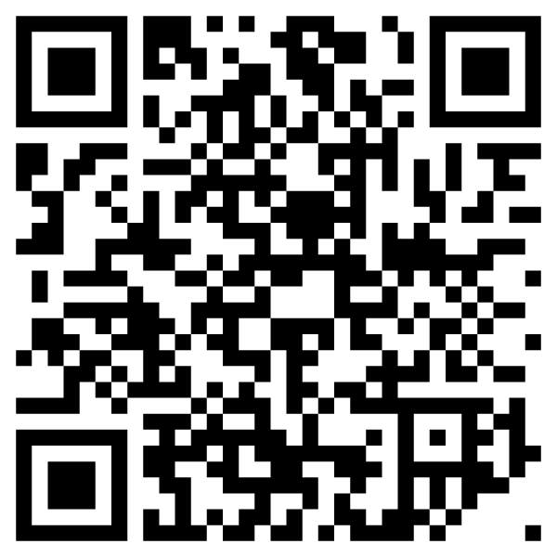
Contact HMA
Grant Information & Timelines
General Inquiries
HMA@caloes.ca.gov
www.caloes.ca.gov/hmgp
Scan to sign up for Hazard Mitigation Program Updates & Notifications

