Slide 1
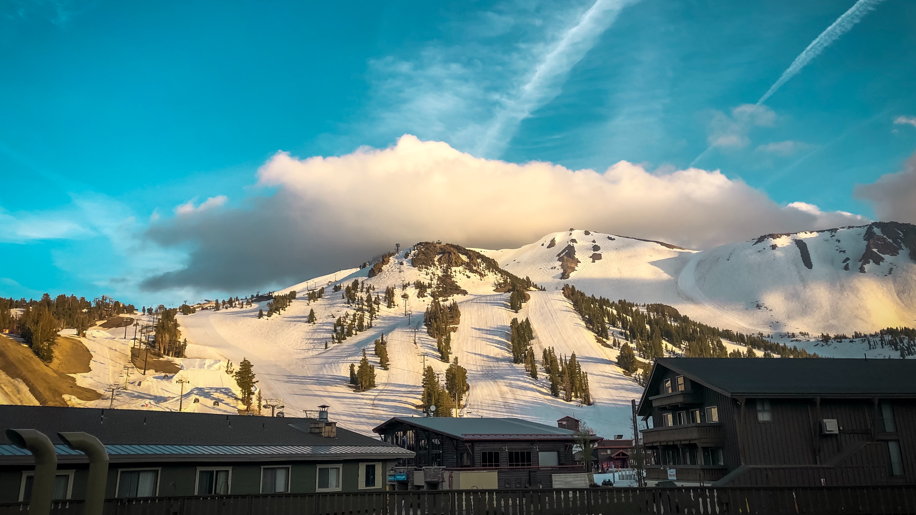
Integrated Climate Adaptation & Resiliency Program (ICARP) Grant Programs

Slide 2
Integrated Climate Adaptation and Resiliency Program
ICARP drives a cohesive, coordinated response to climate change impacts across local, regional and state efforts, prioritizing equity and integrating mitigation with adaptation, via:
Climate Services
The Technical Advisory Council
California Climate Assessments
Adaptation Planning Grants
Regional Resilience Planning & Implementation Grants
Extreme Heat & Community Resilience Grants
ICARP drives a cohesive, coordinated response to climate change impacts across local, regional and state efforts, prioritizing equity and integrating mitigation with adaptation,
Notes:
Before I dig in, I wanted to share a brief overview of the overall program I represent, OPR’s Integrated Climate Adaptation and Resiliency Program, or ICARP. ICARP was created by state law in 2015 to coordinate the state’s response to climate impacts across state agencies and also across levels of governance, to support local planning and implementation. Our program supports this charge through the provision of tools and technical assistance, a public council, a state-level climate assessment, and three investment programs, which I will talk about today.

Slide 3
ICARP Grant Programs
Regional Resilience Grant Program (RRGP)
Adaptation Planning Grant Program (APGP)
Extreme Heat & Community Resilience Grant Program (EHCRP)
The 2021 & 2022 Budget authorized ICARP to develop three new grant programs to fund local, regional, and tribal climate adaptation and resilience efforts across the state.
Notes:
OPR has 3 new grant programs that ICARP has developed, as authorized in the 2021 State Climate Budget. These ICARP grant programs fund tribal, local and regional climate adaptation and resilience efforts across the state.
The Adaptation Planning Grant Program and Extreme Heat & Community Resilience Grant Program and the Regional Resilience Grant Program, that operate through ICARP.

Slide 4
Regional Resilience Grant Program Background & Tentative Timeline
Regional Resilience
Grant Program
This program recently awarded $21.8M in regional resilience efforts.
Funding aims to:
Support local, regional, and tribal entities' regional-scale climate resilience solutions.
Support regions in advancing resilience through three major activities planning and project implementation.
Timeline
Summer ‘22
TAC Workshop
Listening Sessions
Fall ‘22
Draft Guidelines Development
Winter ‘22 – ‘23
Interagency Work Group
Public Comment Period
Spring ‘23
Final Guidelines Development
Summer ‘23
Final Guidelines Release & Solicitation
Winter ‘23
Awards Announced
Notes:
The Regional Resilience Grant program supports local, regional, and tribal entities’ regional-scale climate resilience solutions.
Last month, the program announced awards for 10 planning and 6 implementation projects totaling $21.7M
Awards will support 16 new regional partnerships, uniting public entities, California Native American tribes, Community-Based Organizations, and academic institutions.

Slide 5
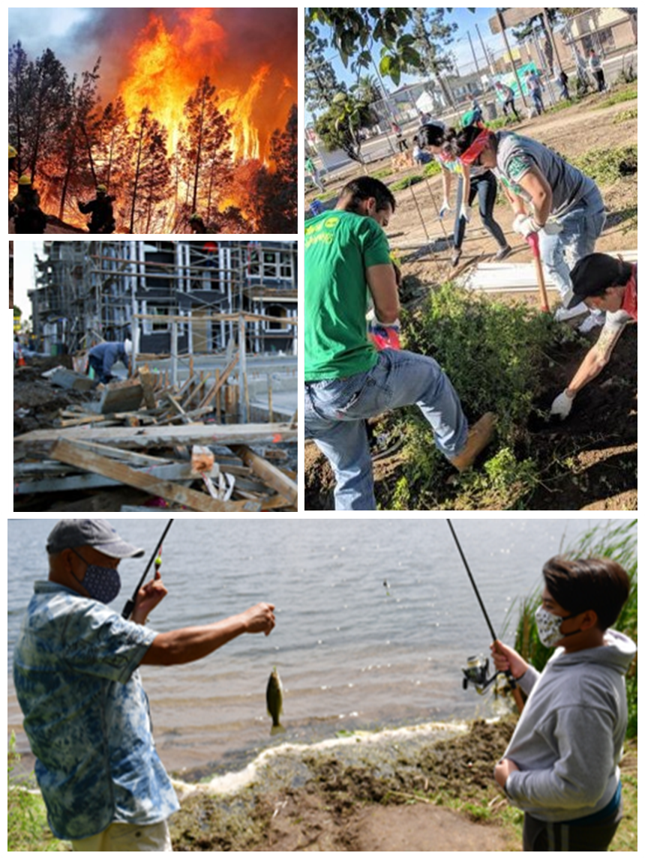
Key Program Priorities
Regional Resilience
Grant Program
Support regional projects aligned with ICARP priorities that reduce climate risks from wildfire, sea level rise, drought, flood, increasing temperatures, and extreme heat events.
Support projects or actions that address the greatest climate risks in the region, particularly in the most vulnerable communities.
Notes:
RRGP focuses on regional partnerships and projects that are aligned with ICARP priorities to reduce climate risks.
The program also aims to address the greatest climate risks in each region, with a strong emphasis on supporting vulnerable communities.
RRGP focuses on addressing a range of climate-related challenges, including wildfires, rising sea levels, droughts, floods, extreme heat events
Another goal of this program is to fill the funding gaps in climate resilience funding, and to support sustainable and cohesive climate resilience projects, and aims to support equitable outcomes.

Slide 6
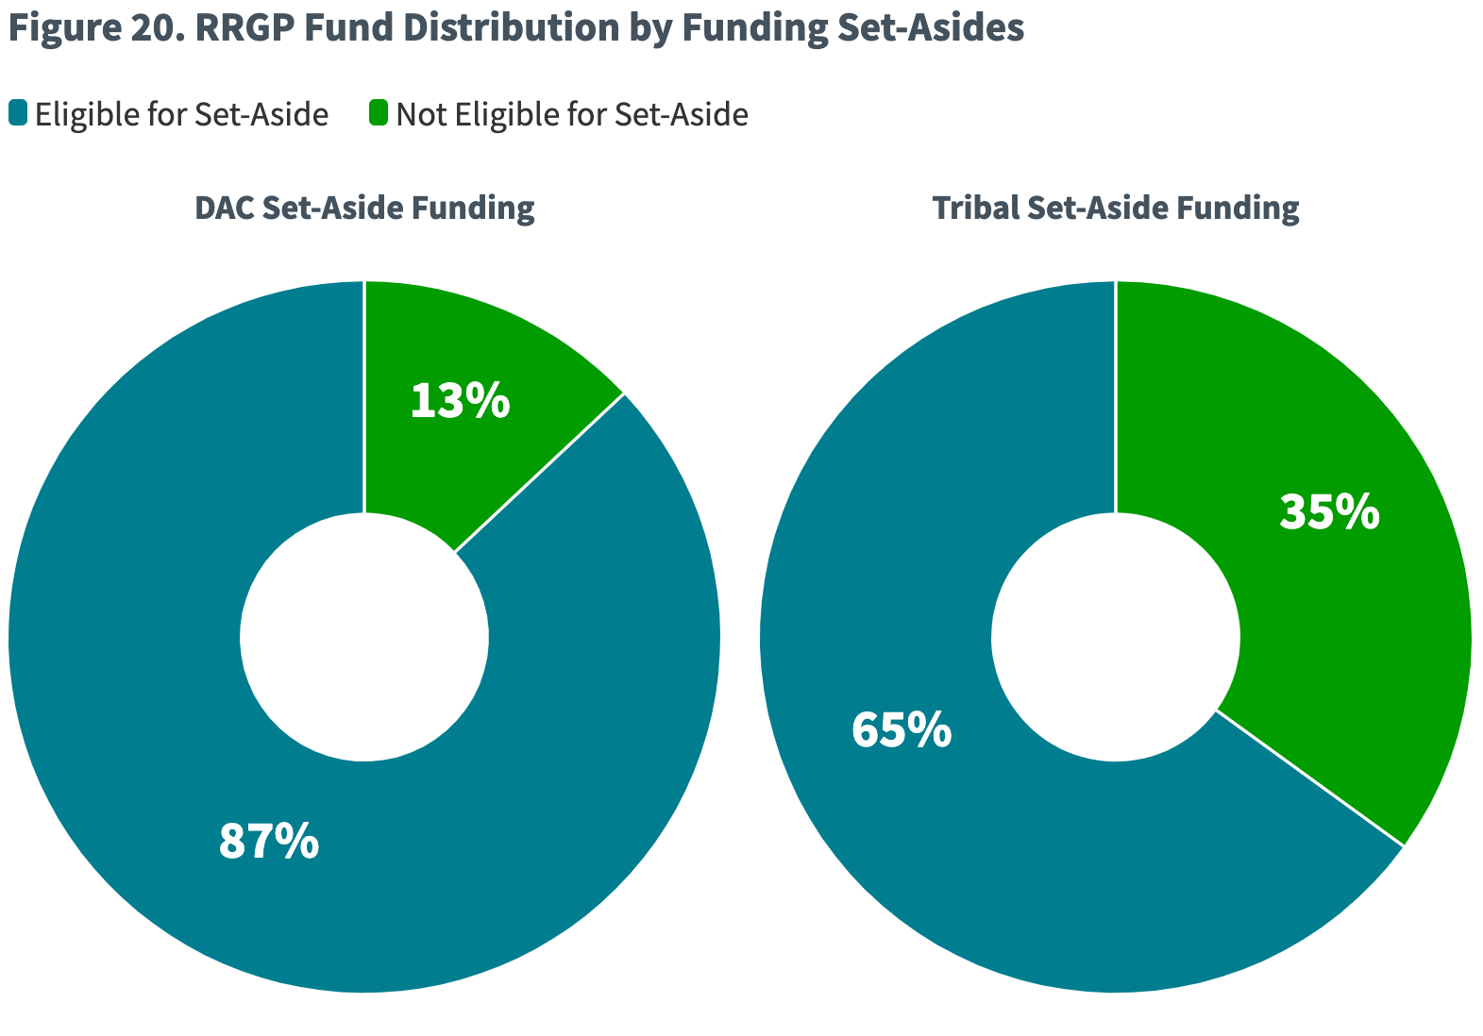
Funding Goals & Set-Asides
Regional Resilience
Grant Program
Notes:
To achieve a regional diversity of projects, RRGP awarded at least one project from each of the nine geographic regions the California Climate Adaptation Strategy identifies.
Additionally, the Regional Resilience Grant program exceeded its Round 1 set-aside goals for disadvantaged communities and California Native American tribes.
86% of Round 1 funding is going to regional partnerships involving California Native American tribes and/or partnerships serving predominantly Disadvantaged Communities. 9 of the 16 grantees is led or co-led by a CA Native American Tribe.
RRGP received a total request of over $111M with only $21.8M to award. The overwhelming response and awarded projects of this program demonstrate the impact of program design that includes funding goals and set-asides for priority communities.
This program also demonstrates that partnerships accelerate action and build capacity. RRGP projects are led by tribal, local and regional governments partnering with non-profits and academic institutions. The projects awarded represent a significant step towards fostering cross-sector collaboration and equity.

Slide 7
Awardee Spotlight
Regional Resilience
Grant Program
Energy-Resilient Fire Services in High-Threat Communities
Le Grand Community Water Program
$3,000,000 (Implementation Grant)
Lead: Redwood Coast Energy Authority
Partners: Yurok Tribe Fire Department, Karuk Tribe Department of Natural Resources, Hoopa Fire Department
$3,000,000 (Implementation Grant)
Lead: Le Grand Athlone Water District
Partners: Le Grand Community Services District, Socio-Environmental Education Network (SEEN)
BUILDING Climate resilience in the central sierra region
Coachella valley regional water resilience plan
$649,335 (Planning Grant)
Lead: Coachella Valley Water District
Partners: Torres Martinez Desert Cahuilla Indians, Pueblo Unido Community Development Corporation
$650,000 (Planning Grant)
Lead: County of Nevada
Partners: Town of Truckee, Nevada City Rancheria Nisenan Tribe, Truckee Tahoe Airport District, Truckee Donner Public Utility District, Sierra Business Council
Notes:
Regional resilience grant program awarded projects identified their highest priority climate risks for their region. Of the 16 projects awarded,
9 projects address multiple climate risks
4 address wildfire specifically
1 each addressed Sea-level rise, Extreme Heat and Drought
The following awarded projects exemplify RRGP’s goals.
In the North Coast of California, RRGP supports the Energy-Resilient Fire Services in High-Threat Communities project with an award of $3,000,000. Led by the Redwood Coast Energy Authority and partnering with several fire departments including the Yurok Tribe Fire Department, Karuk Tribe Department of Natural Resources, and Hoopa Fire Department, the project will install energy-resilience infrastructure for fire stations in high-risk areas, ensuring continuous emergency response in remote and vulnerable communities. The project addresses wildfire risks and provides energy resilience, green workforce development, and public safety benefits within the boundary of Humboldt County and the Hoopa, Karuk, and Yurok Tribal lands. The project also creates energy resilience during extreme heat events, floods, and landslides. Humboldt County was ranked as the eighth poorest county in the state by 2017-2021 census data. Most land in Humboldt County is located within a medium or high-fire severity zone and many remote communities served by the project experience longer and more frequent outages, chronic power insecurity, and unavailability. The region’s extensive river systems can fragment these smaller communities through flooding, and roadways are prone to landslides. Fire station personnel in these areas not only respond to fires and disasters but also to medical emergencies and public safety services. Most stations in the project area rely on local unpaid volunteers with limited operating budgets.
Another notable RRGP-awarded project is in the San Joaquin Valley. The Le Grand Community Water Program supported by an award of $3,000,000 is led by the Le Grand Athlone Water District partnering with the Le Grand Community Services District and the community-based organization, Socio-Environmental Education Network (SEEN). The Le Grand Community Water Program Project will address drought and flood risks through sustainable groundwater management practices that benefit vulnerable communities including new well construction, irrigation canal connections, and community education programs. The project addresses drought and flood risks and provides agricultural benefits to the region. 70% of the region is identified as disadvantaged by CalEnviroScreen. The most urgent needs of this community are protection from flooding and balancing the groundwater supply with the demands of domestic drinking water and agriculture. The project’s region includes the rural area southeast of the City of Merced in Merced County, California. The region consists of rural communities of El Nido, Plainsburg, Le Grand, and Planada, which experience the effects of drought, flooding, land subsidence, and declining groundwater levels. Several creeks that run through the region become inundated during storm events and have caused disastrous flooding to the disadvantaged communities in the region. This regional-scale project will build climate resilience by creating water connectivity between Merced Irrigation District, Le Grand-Athlone Water District, and Le Grand Community Services District. Physical resiliency is further supported with a science-based curriculum offered in local elementary and after-school programs.

Slide 8
Adaptation Planning Grant Program Background & Tentative Timeline
Adaptation Planning
Grant Program
Timeline
Spring ‘22
TAC Workshop
Listening Sessions
Summer - Fall ‘22
Draft Guidelines Development
Fall ‘22
Public Comment Period
Final Guidelines Development
Winter ’22 – ‘23
Final Guidelines Release & Solicitation
Spring ‘23
Application Deadline
Summer ‘23
Awards Announced
This program funds local, regional, and tribal adaptation planning efforts.
Round 1 $8.0 million was awarded with amounts ranging between $150,000-$650,000.
Round 2 $9,500,000 will be available early 2024. Funding targets for Tribes, Disadvantaged Communities, and Small & Rural Communities.
No match funding required
Notes:
The Adaptation Planning Grant Program (APGP) leverages $25 million over 3 rounds to support local, regional, and tribal communities engaging in integrated climate adaptation planning. By facilitating climate adaptation planning, APGP supports the development of climate-resilient projects across the State.
We have $8 million available for round 1 funding.
The Awards will be from between $150,000 to 650,000
Here is a quick look at our program timeline
We kicked off engagement in March 2022, developed the draft program guidelines, had a public comment period, and launched the intent survey in November , and opened the application period on January 6 which closed recently on March 31. We received over 140 intent surveys and over the next couple weeks will be selecting a minimum of 12 finalists.

Slide 9
Key Program Priorities
Adaptation Planning
Grant Program
• Enhance Accessibility and Diversity
• Prioritize Vulnerable Communities-Centric Approach
• Emphasize Integrated Infrastructure Planning
• Build Community Capacity for Resilience
• Elevate Equity in the Planning Process
Notes:
APGP is all about funding climate adaptation planning efforts." It's not just about funding; it's about fostering inclusivity and flexibility.
"One of the program's key goals is to
Enhance Accessibility and Diversity
APGP aims to minimize barriers for applicants.
We're dedicated to ensuring that both applicants and awardees represent a broad spectrum of geographic, economic, and demographic diversity.
Prioritize Vulnerable Communities-Centric Approach:
We prioritize the unique needs of vulnerable communities.
This includes an all-risk approach to adaptation planning, preparing communities for various climate change impacts.
We encourage community preparedness, which is crucial in the face of cascading and compounding climate impacts.
Emphasize Integrated Infrastructure Planning:
"A significant focus is placed on the integration of social and physical infrastructure planning."
"This involves addressing cross-sector issues that intersect with various climate risks."
"For instance, we look at transportation, economic stability, housing, natural resource management, hazard mitigation, public infrastructure, and healthy food access."
"By doing so, we prepare communities for the multifaceted impacts of climate change."
Build Community Capacity for Resilience:
"Another critical goal is to enhance statewide capacity for adaptation and resiliency planning."
"We do this by providing technical support, facilitating peer-to-peer learning, establishing communities of practice, and promoting information sharing."
"This empowers communities with the knowledge and resources needed to adapt effectively to climate change."
Elevate Equity in the Planning Process:
"Last but not least, APGP places a strong emphasis on equity."
"We prioritize fair access to community investment benefits and privileges."
"Funding is directed to disadvantaged communities, and we support projects that address historical disparities."
"Our goal is to create a more equitable future for all."

Slide 10
Eligible Applicants and Activities
Adaptation Planning
Grant Program
Applicants
Activities
Eligible
Local Public Entities
California Native American Tribes
Community-Based Organizations & Non-profits
Ineligible
For-profit entities
State Agencies
Important Requirements
Co-applicants required
Eligible
Identify climate resilience priorities
Engage in integrated climate planning
Plan social and physical climate resilient infrastructure projects
Strengthen local coordination, leadership, knowledge, and skills to implement co-beneficial projects
Increase access to additional state and federal funding
Ineligible
Implementation of construction projects
Environmental studies, plans, or documents required for CEQA or NEPA
Notes:
Eligible Applicants
•Local Public Entities, California Native American Tribes (Tribes), Community-Based Organizations, including, but not limited to 501(c)(3) nonprofit organizations, non-governmental organizations, philanthropic organizations, foundations, and other organizations with a history of representing vulnerable communities.
•There should be a minimum of one (1) Co-Applicant in addition to the Lead Applicant. More than one (1) Co-Applicant is encouraged. Either the Lead Applicant or one of the Co-Applicants should be a public entity or Tribe. Community-based organizations should partner with a local public entity or Tribe as listed above to ensure that planning efforts funded can ultimately be implemented by local, regional, or tribal entities. Public entities should partner with a community-based organization to ensure that planning efforts are centering the needs of vulnerable communities.
•In each of these cases we understand that one size fits all does not work – in these cases we will accept a justification as to why partnership with a public entity or with a community based organization is not feasible. See the guidelines for more details.
Eligible Activities
Emphasis on planning
California Adaptation Planning Guide (2020)

Slide 11
Round 1 Awardee Spotlight
Adaptation Planning
Grant Program
Yosemite Slough Adaptation Plan
San Rafael Climate Adaptation Planning Collaborative
$649,000
Plan focuses on building capacity, developing equitable adaptation strategies, and positioning Yosemite Slough for federal funding
$644,200
Understand climate hazards, prioritize adaptation measures, and build climate capacity
San Mateo One watershed Climate Resilience Framework
LA’s Cool capital Stack
$506,000
Develop pipeline of community-led climate infrastructure projects to address extreme heat and other climate hazards
$649,648
Model for community-led risk assessment for watershed management, break down silos in water-related infrastructure planning
Notes:
Yosemite Slough Adaptation Plan - $649,000 The Yosemite Slough Adaptation Plan aims to address the disparity in adaptation planning between the Bayview Hunters Point neighborhood and the rest of San Francisco's urban waterfront. The plan focuses on building community capacity, developing equitable adaptation strategies, and positioning Yosemite Slough for federal funding. Project partners include the San Francisco Planning Department, En2Action, BAYCAT, San Francisco Estuary Institute, California State Parks Foundation, and other city agencies.
San Rafael Climate Adaptation Planning Collaborative - $644,200 The San Rafael Climate Adaptation Planning Collaborative will work with disproportionately vulnerable communities in partnership with local organizations in the Canal neighborhood to co-create solutions for improved safety and resilience. Partners will work to improve understanding of climate hazards, prioritize adaptation measures, and build climate capacity within community-based organizations while providing STEM educational opportunities for students from the Canal neighborhood.
San Mateo County OneWatershed Climate Resilience Framework - $649,648 The San Mateo County OneWatershed Climate Resilience Framework Project aims to develop a model for community-led risk identification, a replicable watershed approach, resilient neighborhoods and watersheds, and breaking down silos in water-related infrastructure planning to address climate adaptation challenges holistically.
LA’s Cool Capital Stack - $506,000 The LA Cool Capital Stack creates a pipeline of viable community-led climate resilient infrastructure projects designed to strengthen LA County communities most vulnerable to extreme heat and other climate hazards. It establishes an agency-community collaborative that brings together LA County, Metro, and Infrastructure Justice Los Angeles (IJLA) to co-create an approach to equitable, climate resilient infrastructure development.

Slide 12
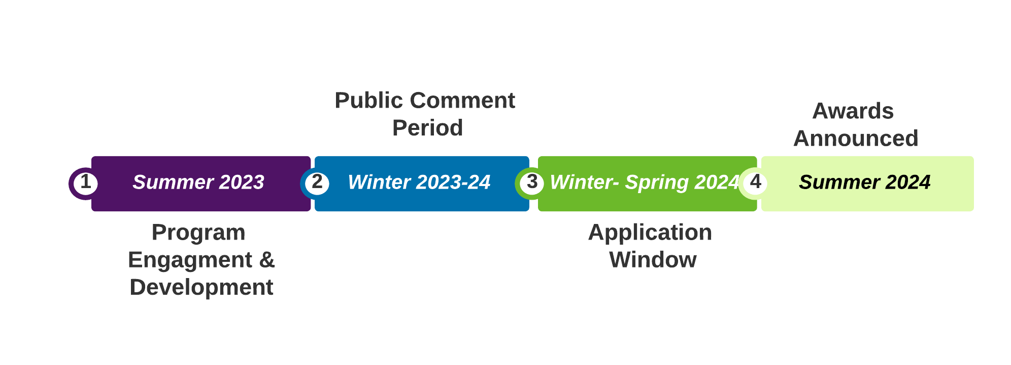
APGP Timeline
Adaptation Planning
Grant Program

Slide 13
Extreme Heat & Community Resilience Background & Tentative Timeline
Extreme Heat &
Community Resilience
This program will invest funding in local, regional, and tribal heat reduction and mitigation efforts. Funding aims to:
Build capacity for heat action planning and implementation in heat-burdened communities through funding and technical support.
Create frameworks for change
Timeline
Spring ‘23
TAC Workshop
Listening Sessions
Summer - Fall ‘23
Draft Guidelines Development
Fall ‘23- Current Stage
Public Comment Period
Final Guidelines Development
Winter ’23 – ‘24
Final Guidelines Release & Solicitation
Spring ‘24
Application Deadline
Summer ‘24
Awards Announced
Notes:
The Extreme Heat and Community Resilience Program will fund planning and implementation projects to reduce the impacts of extreme heat and build community resilience. The Program will build frameworks for change and invest in local, regional, and tribal projects that strengthen communities that are vulnerable to heat. EHCRP is dedicated to supporting a statewide movement focused on building resilience to extreme heat through job creation, placemaking, place-keeping, and protecting the health of Californians who are most vulnerable to extreme heat
This program will fund $118 million in planning and implementation on extreme heat resilience:
Planning grants will facilitate the development of partnerships development to strengthen collaboration as communities prepare for extreme heat events.
Implementation grants will support communities in piloting programs and infrastructure projects

Slide 14
Key Program Priorities
Extreme Heat &
Community Resilience
Explicitly and meaningfully prioritize equitable outcomes, particularly in the most heat vulnerable communities.
Coordinate the state’s efforts to address extreme heat and the urban heat island effect and provide financial and technical assistance to eligible entities
Encourage communities to equitably plan for extreme heat events by centering the needs of vulnerable communities.
Build statewide capacity to plan for and implement equitable planning strategies
Notes:
The Goals of Extreme Heat and Community Resilience Program are the following:
Equity: Explicitly and meaningfully prioritize equitable outcomes, particularly in the most heat vulnerable communities. Provide technical support and establish an inclusive funding program that removes barriers for applicants and ensures that awardees represent a wide range of geographic, economic, and population diversity.
Coordination: Coordinate the state’s efforts to address extreme heat and the urban heat island effect and provide financial and technical assistance to eligible entities to support local and regional efforts to mitigate the impacts of, and reduce the public health risks of, extreme heat or the urban heat island effect.
Planning: Encourage communities to equitably plan for extreme heat events by centering the needs of vulnerable communities.
Statewide Capacity: Build statewide capacity to plan for and implement equitable planning strategies by supporting peer-to-peer learning, communities of practice, information sharing, and publishing replicable case studies on the State Adaptation Clearinghouse.

Slide 15
Eligible Applicants and Activities
Extreme Heat &
Community Resilience
Applicants
Activities
Eligible
Local Public Entities
California Native American Tribes
Community-Based Organizations & Non-profits
Ineligible
For-profit entities
State Agencies
Planning ($100,000-$750,000 per grant)
Capacity development & pre-planning
Long range planning
Plan alignment
Implementation ($100,000-$5 Million)
Public awareness projects
Community services and response
Infrastructure projects
Nature based solutions
Notes:
Eligible Applicants
•Local Public Entities, California Native American Tribes (Tribes), Community-Based Organizations, including, but not limited to 501(c)(3) nonprofit organizations, non-governmental organizations, philanthropic organizations, foundations, and other organizations with a history of representing vulnerable communities.
•Co-applicant requirements vary depending on the type of grant that the applicant is perusing.
Eligible Activities
We plan to offer four distinct grant types
Small Planning Grants and Large Planning Grants
Small Implementation Grants and Large Implementation Grants
The small planning grants are available to communities that want to develop partnerships to advance response efforts to extreme heat and/or to build long-term resilience to extreme heat
Large planning grants are meant to build community-wide programs and/or infrastructure that can transform how communities address extreme heat.
Small implementation grants fund single site or technology projects.
Conversely, large implementation grants fund projects that combine multiple infrastructure solutions or location

