Slide 1
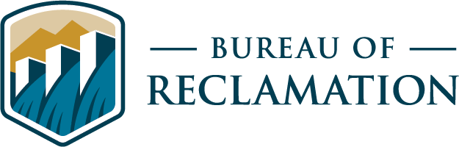
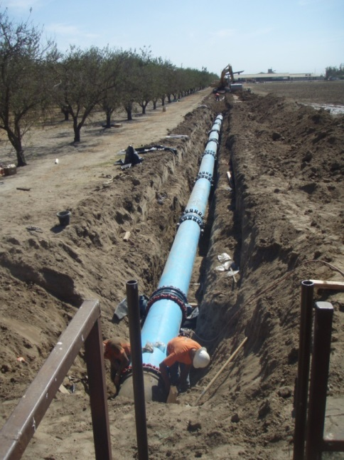
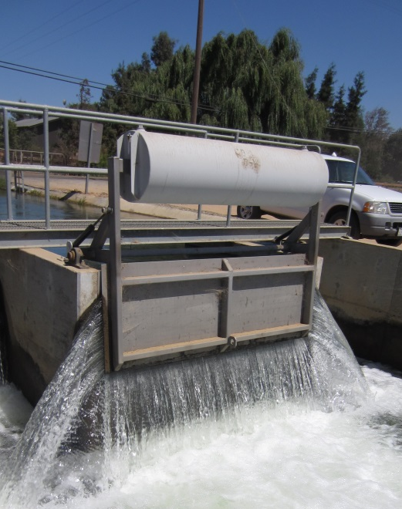
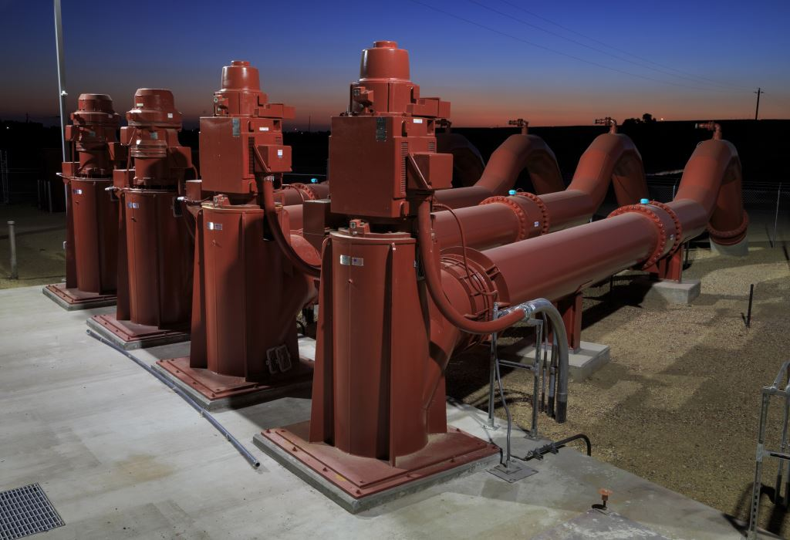
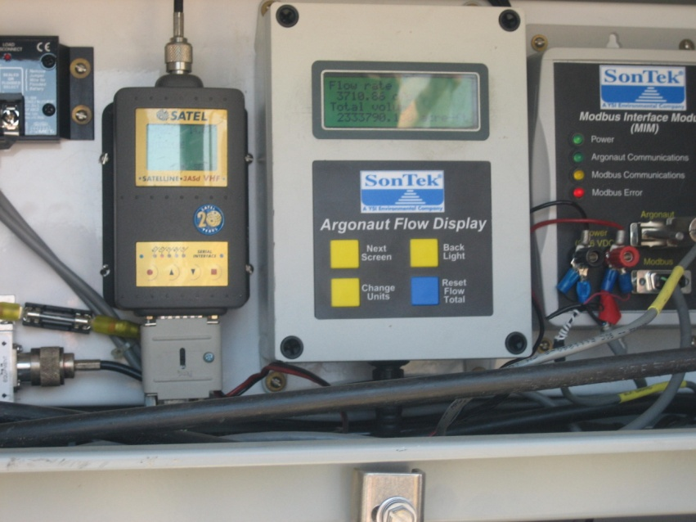
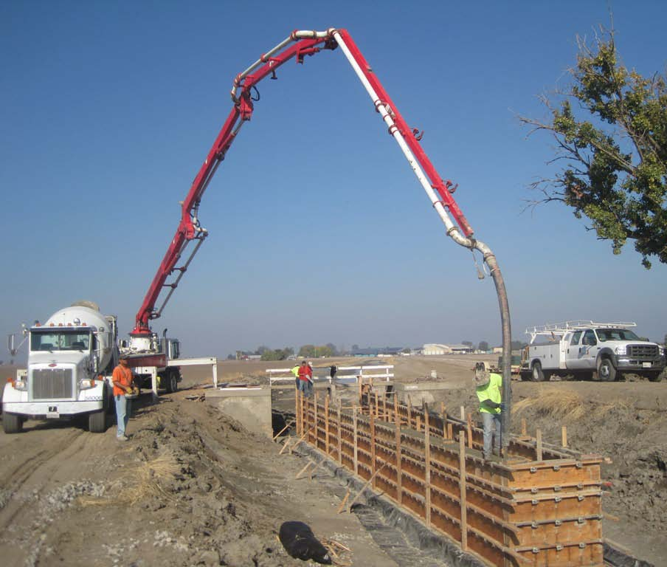

Water Conservation: Financial Assistance Opportunities
U.S. Department of the Interior
Spring 2024

Slide 2
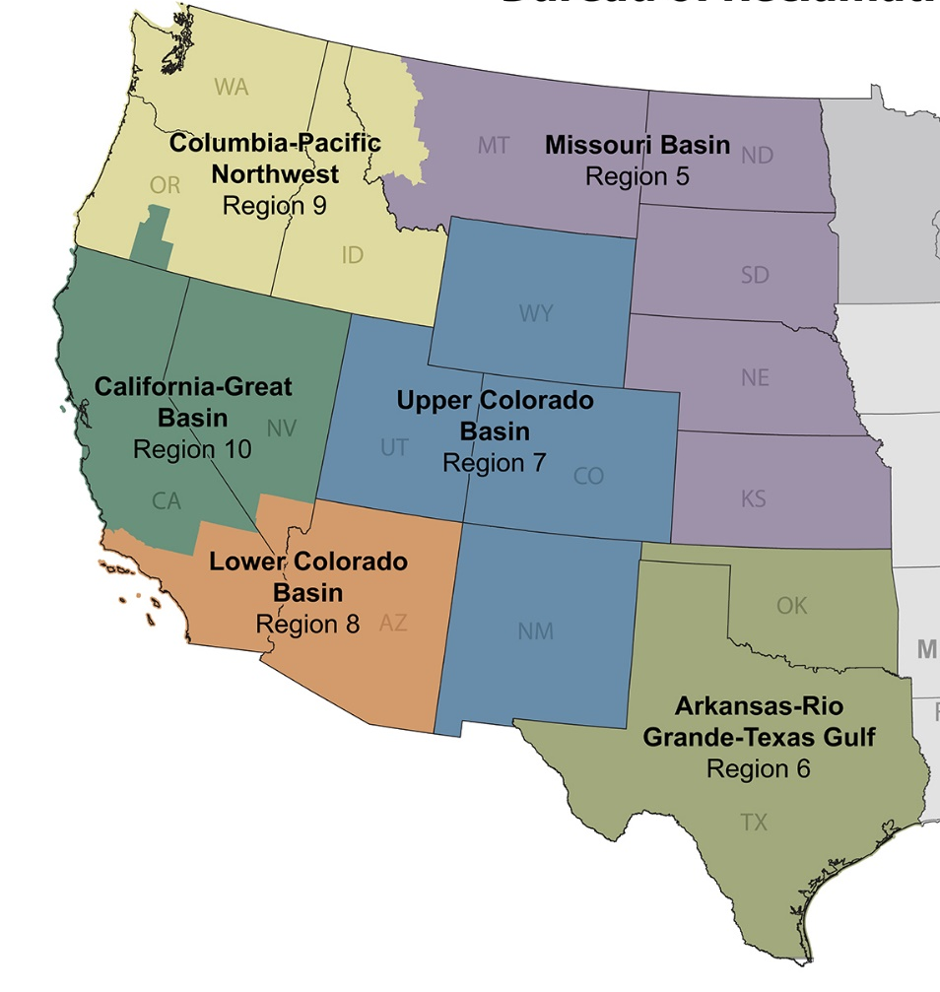
Bureau of Reclamation – Five Regions
17 States comprise Five Regions:
California-Great Basin
Columbia-Pacific Northwest
Lower Colorado Basin
Missouri Bain and Arkansas-Rio Grande-Texas Gulf
Upper Colorado Basin
California is in both the CGB and LCB Regions

Slide 3
Reclamation’s Water Conservation Team
Region | Team Member | Telephone Number | Email Address
CGB | Jake Berens | 530-892-6203 | JBerens@usbr.gov
CGB | Shalese P. Henderson | 916-978-5271 | SPhenderson@usbr.gov
CGB | Gene Lee | 916-978-5219 | GLee@usbr.gov
CGB | Deb Page | 775-884-8392 | DPage@usbr.gov
CGB | Anna Sutton | 916-978-5214 | ASutton@usbr.gov
CGB | David T. White | 916-978-5208 | DWhite@usbr.gov
LCB | Troy Thompson | 951-695-5310 | TThompson@usbr.gov

Slide 4
Reclamation Funding Opportunities
CGB Region
Bay-Delta CALFED Water Use Efficiency
Agricultural Water Use Efficiency
Native American Affairs Technical Assistance Program
    Applied Science Grants
    Aquatic Ecosystem Restoration Program
    Basin Studies and Baseline Assessments
    CWMP – Cooperative Watershed Management Program
    Drought Program: Contingency Planning, Emergency Response, and Resiliency
    Environmental Water Resources Projects
    Project Design
    Reservoir Operations Pilot
    SWEP – Small-Scale Water Efficiency Projects
    Title XVI Program and Desalination Construction
    Water Conservation Field Services Program
    Water Marketing Strategy Grants
    WEEG – Water and Energy Efficiency Grants
All Reclamation Regions
WaterSMART
www.usbr.gov/watersmart

Slide 5




Reclamation Financial Assistance
General Information
Up to 50% of the project’s cost and no more than $25 million
States, tribes, irrigation districts, water districts, and other entities with water or power delivery authority
Awards are made through a competitive process
Notice of Funding Opportunities (NOFO) are posted to www.grants.gov
Notes:
Suggest to Bookmark the website and check it monthly starting in Oct/Nov of each year
Read the FOA, what is the objective of the FOA
Register early with Grants.gov
If your agency is selected for an award, register with ASAP, which is the online payment software
If your agency is not select, as for a debrief to be able to prepare for the next year or next FOA
Understand that a 50% cost share is non-Federal funding, so if you receive State funding for your project, that can count as your portion of your cost share.

Slide 6
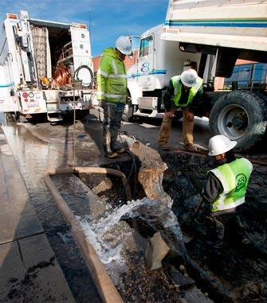
  CGB: Bay-Delta CALFED Water Use Efficiency Grants
Eligible applicants must be located within the CALFED Solution Area
Significant benefits to the Bay-Delta
Since 2010, over 70 grants have conserved or better managed over 303,000 acre-feet (i.e., +100 billion gallons) of water
Recent NOFO: BOR-CGB-21-F001
EBMUD Leak Detection
Notes:
2010-2016 = 60 grants = 302,492 AFY is a combination of water conservation and water better management
2010-2016 = 60 grants = 149,719 AFY water conservation and 152,777 AFY water better management

Slide 7
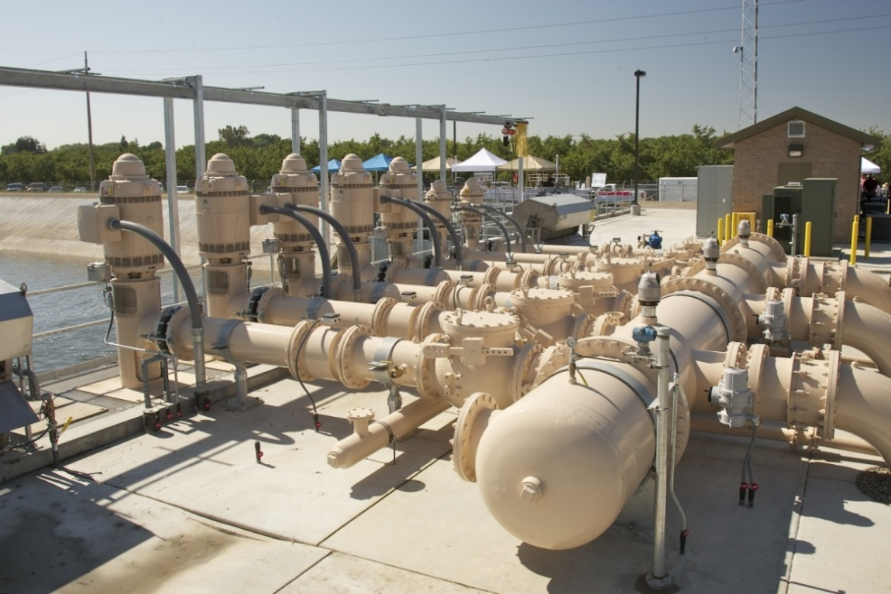
CGB: Agricultural Water Use Efficiency Grants
Partnership with Natural Resource Conservation Service (NRCS) - Fostering District/Farmer Partnerships
Increase the capability of on-farm water conservation projects
Encourage supplier/grower partnerships to identify district/regional needs and opportunities
Recent NOFO: BOR-MP-19-F003
South San Joaquin Irrigation Dist.
Notes:
Partnership with NRCS
Reclamation funding helps the districts side
And NRCS funding helps the farmer side
When applying, look for farmers that are committed to participate and are ready to go

Slide 8



U.S. Department of the Interior Bureau of Reclamation WaterSMART Status of WaterSMART Program Funding Opportunities
Program | Eligible Applicants | Federal/Non-Federal Cost Share | Funding | Current Status
Water and Energy Efficiency Grants On-the-ground water management improvement projects, including projects that conserve water and address water supply reliability. Program Contact: Josh German jgerman@usbr.gov | Category A Applicants: States, Indian tribes, irrigation districts, water districts, or other organizations with water or power delivery authority. Category B Applicants: Nonprofit conservation organizations that are acting in partnership and with the agreement of an entity described above. Applicants must be located in the 17 Western States or United States Territories (i.e., Arizona, California, Colorado, Idaho, Kansas, Montana, Nebraska, Nevada, New Mexico, North Dakota, Oklahoma, Oregon, South Dakota, Texas, Utah, Washington, and Wyoming), Alaska, Hawaii, American Samoa, Guam, the Northern Mariana Islands, the Virgin Islands, or Puerto Rico. | Up to $500,000 for projects to be completed within two years; up to $5 million for large projects to be completed within three years. Non-Federal Cost Share: 50% or greater. | Reclamation will allocate WaterSMART Grants Bipartisan Infrastructure Law (BIL) under this funding opportunity. Approximately $50 million is anticipated to be available under the FY24 funding opportunity. | The FY24 and FY25 Funding Opportunity was posted November 12, 2023. The first round of applications were due February 22, 2024 and selections are expected July 2024. The second round of applications are due October 30, 2024.
Small-Scale Water Efficiency Projects Small water efficiency improvements that have been identified through previous planning efforts. Program Contact: Nickie McCann nmccann@usbr.gov |  | Up to $100,000 for projects to be completed within two years. Total project costs should generally be less than $225,000. Non-Federal Cost Share: 50% or greater. | Reclamation will distribute WaterSMART Grants Congressional appropriations under this funding opportunity. Approximately $12 million in is anticipated to be available under the funding opportunity. | The FY24 and FY25 Funding Opportunity was posted November 2, 2023. The first round of applications were due February 6, 2024 and selections are expected May 2024. The second round of applications are due July 9, 2024, third round of applications are due January 14, 2025, and fourth round of applications are due July 8, 2025.
www.usbr.gov/WaterSMART

Slide 9
Program | Eligible Applicants | Federal/Non-Federal Cost Share | Funding | Current Status
Drought Resiliency Projects Funding for on-the-ground projects and modeling tools that will increase water reliability and improve water management. Program Contact: Sheri Looper slooper@usbr.gov | Category A Applicants: States, Indian tribes, irrigation districts, water districts, or other organizations with water or power delivery authority. Category B Applicants: Nonprofit conservation organizations that are acting in partnership and with the agreement of an entity described above. Applicants must be located in the 17 Western States, Alaska, Hawaii, American Samoa, Guam, the Northern Mariana Islands, the Virgin Islands, or Puerto Rico. | Up to $500,000 for projects to be completed within two years; up to $5 million for projects to be completed within three years. Non-Federal Cost Share: 50% or greater. Up to $10 million for domestic water supply projects for Tribes or disadvantaged communities that do not have reliable access to water supplies. To be completed within three years. 5% Non-Federal cost share with possible waiver available. | This funding opportunity will be used to allocated $30 million FY 23 and available FY 24 appropriations. In addition, Reclamation will under this funding opportunity to allocate funds from the BIL and the Inflation Reduction Act (IRA). | FY24 Funding Opportunity selections were announced May 6, 2024. 42 projects were selected to receive $147 million in BIL, IRA, and appropriated funds.
www.usbr.gov/WaterSMART

Slide 10
Program | Eligible Applicants | Federal/Non-Federal Cost Share | Funding | Current Status
Environmental Water Resources Water conservation and efficiency projects that result in quantifiable and sustained water savings and benefit ecological values; water management or infrastructure improvements to mitigate drought-related impacts to ecological values; and watershed management or restoration projects benefitting ecological values that have a nexus to water resources or water resources management. Program Contact: Robin Graber rgraber@usbr.gov | Applicant eligibility is as described above with the addition of Category C Applicants as described below. Category C Applicants: Non-profit conservation organizations submitting an application for a project to implement a nature-based solution on Federal land may submit an application without a Category A partner, if they demonstrate that entities described in Category A from the applicable service area have been notified and do not object to the project. | In general, up to $3,000,000 in Federal funds may be awarded for projects to be completed within three years and with total project costs no greater than $6,000,000. Up to $5,000,000 in Federal funds may be awarded to a watershed group, which meets the definition in Section 6001(6) of the Cooperative Watershed Management Act, to be completed within five years, with no total project cost limitation. Non- Federal Cost Share: 25% of total project costs | This funding opportunity will be used to allocate several sources of BIL funding. Approximately $50 million for the June 18, 2024, deadline and approximately $45 million for the March 11, 2025, deadline. | The FY23 Funding Opportunity selections were announced on November 15, 2023. 30 projects were selected to receive $51 million in BIL funds. The FY24/25 Funding Opportunity was posted on April 18, 2024 with the first round of applications due June 18, 2024 and the second round due March 11, 2025.
Applied Science Grants Projects to develop hydrologic information and water management tools, improve modeling and forecasting capabilities, and nature based solutions. Program Contacts: Stephanie Micek smicek@usbr.gov Avra Morgan aomorgan@usbr.gov | States, Indian tribes, irrigation districts, water districts, universities, non-profit research institutions, organizations with water or power delivery authority, or non-profit organizations located in the 17 Western States, Alaska, Hawaii, American Samoa, Guam, the Northern Mariana Islands, the Virgin Islands, or Puerto Rico. | Up to $400,000 per agreement for a project that can be completed within two years. Non-Federal Cost Share: 25-50% or greater. | This funding opportunity will be used to allocate approximately $10 million in FY23 and available FY24 appropriations. | FY23 Funding Opportunity selections were announced on April 17, 2024. 51 projects were selected to receive $13.3 million in BIL and appropriated funds. Reclamation expects to post the FY24 Funding Opportunity in September 2024.
www.usbr.gov/WaterSMART

Slide 11
Program | Eligible Applicants | Federal/Non-Federal Cost Share | Funding | Current Status
Aquatic Ecosystem Restoration Funding for the study, design and construction of aquatic ecosystem restoration projects that are collaboratively developed, have widespread regional benefits, and are for the purpose of improving the health of fisheries, wildlife, and aquatic habitat through restoration and improved fish passage. Program Contacts: Avra Morgan aomorgan@usbr.gov Irene Hoiby ihoiby@usbr.gov | Category A Applicants: States, Tribes, irrigation or water districts, state, regional, or local authorities, agencies established under State law for the joint exercise of powers, and other entities or organizations that own a dam that is eligible for upgrade or modification located in the 17 Western States, American Samoa, Guam, the Northern Mariana Islands, or the Virgin Islands. Category B Applicants: Nonprofit conservation organizations acting in partnership with an entity above, with respect to a project involving land or infrastructure owned by the Category A entity. | Non-Federal Cost Share: 35% | Approximately $95 million available for aquatic ecosystem restoration projects under BIL in FY23 and FY24 (including funding for Section 40904 Multi- Benefit Projects To Improve Watershed Health) will be provided through this Funding Opportunity. | The FY23 and FY24 Funding Opportunity was posted March 14, 2023. Applications for FY23 funding were due June 1, 2023, and selections were announced December 19, 2023. 18 projects were selected to receive $51 million in appropriated funds Applications received by January 24, 2024 are currently under review for FY24 funding. Selections are expected June 2024.
www.usbr.gov/WaterSMART

Slide 12
Program | Eligible Applicants | Federal/Non-Federal Cost Share | Funding | Current Status
Cooperative Watershed Management Program - Phase I Watershed group development, watershed restoration planning, and watershed management project design. Program Contact: Robin Graber rgraber@usbr.gov | States, Indian tribes, local and special districts (e.g., irrigation and water districts), local governmental entities, and non-profit organizations that are located in the 17 Western States, Alaska, Hawaii, American Samoa, Guam, the Northern Mariana Islands, the Virgin Islands, or Puerto Rico. | Up to $300,000 may be awarded to an applicant per year, for a period of up to three years. Non-Federal Cost Share: No non‑Federal cost-share required. | Reclamation will allocate Congressional appropriations and BIL funding under this funding opportunity. Up to $20 million is anticipated to be available. | FY23 and FY24 Funding Opportunities were posted August 7, 2023. First round of applications were due by December 5, 2023. Selections are expected in late May 2024. The second round of applications are due by September 3, 2024.
www.usbr.gov/WaterSMART

Slide 13
Program | Eligible Applicants | Federal/Non-Federal Cost Share | Funding | Current Status
Planning and Project Design Grants Collaborative planning and design projects to support water management improvements, include the following activities: Water Strategy Grants (WSG): Planning projects to support water management solutions, such as water marketing, water conservation, drought resilience, and ecological resilience Project Design Grants (PDG): Projects to develop the final design of on- the-ground water management construction and restoration projects. Drought Contingency Planning (DCP): Projects to develop a new or update an existing Drought Contingency Plan. Program Contacts: WSG Irene Hoiby ihoiby@usbr.gov PDG Nickie McCann nmccann@usbr.gov DCP Sheri Looper slooper@usbr.gov | Category A Applicants: States, Indian tribes, irrigation districts, water districts, or other organizations with water or power delivery authority. Category B Applicants: Nonprofit conservation organizations that are acting in partnership and an entity described above. Applicants must be located in the 17 Western States, Alaska, Hawaii, American Samoa, Guam, the Northern Mariana Islands, the Virgin Islands, or Puerto Rico. Note: Drought Contingency Planning funding is limited to Category A and applicants located in the 17 Western States, Hawaii, American Samoa, Guam, the Northern Mariana Islands, or the Virgin Islands. | Up to $400,000 for projects that can be completed within 3 years. Non-Federal Cost Share: 25-50%. Proposals for the planning or design of projects to provide domestic water supplies to disadvantaged communities may be eligible for 0% non-Federal cost share. | Approximately $35 million in available program funds, including BIL funding (including funding for Section 40904 Multi-Benefit Projects To Improve Watershed Health) will be provided through this Funding Opportunity. | The FY23 and FY24 Funding Opportunity was posted August 7, 2023. Selections from the first round of applications were annouced April 23, 2024. 34 projects were selected to receive $11.1 million in BIL and appropriated funds. The second round of applications are due May 21, 2024.
www.usbr.gov/WaterSMART

Slide 14
Program | Eligible Applicants | Federal/Non-Federal Cost Share | Funding | Current Status
Title XVI Authorized Projects Funding for planning, design, and construction of specific congressionally authorized water recycling and reuse projects. Program Contact: Maribeth Menendez mmenendez@usbr.gov | Sponsors of water reclamation and reuse projects specifically authorized for funding under Title XVI of P.L. 102-575. | Federal funding is limited to 25% of the total project cost, up to $20 million, unless otherwise specified by Congress. Non-Federal Cost Share: 75% or greater. | Funding opportunities will be used to allocate up to $179 million in BIL funding and $60 million in annual appropriations. | The FY23 and FY24 Funding Opportunity was posted September 28, 2023. First round of applications were due by December 7, 2023. Selections are expected May 2024. The second application submission deadline is September 30, 2024.
Title XVI WIIN Act Water Reclamation and Reuse Projects Funding for planning, design, and construction of WIIN Act water recycling and reuse projects. Program Contact: Maribeth Menendez mmenendez@usbr.gov | Sponsors of water reclamation and reuse projects with completed feasibility studies that have been submitted to Reclamation for review. Entities must be located in the 17 Western States, Hawaii, American Samoa, Guam, the Northern Mariana Islands, or the Virgin Islands. | Federal funding is limited to 25% of the total project cost, up to $30 million. Non-Federal Cost Share: 75% or greater. |  | The FY23 and FY24 Funding Opportunity was posted September 28, 2023. First round of applications were due by December 7, 2023. Selections are expected May 2024. The second application submission deadline is September 30, 2024.
www.usbr.gov/WaterSMART

Slide 15
Program | Eligible Applicants | Federal/Non-Federal Cost Share | Funding | Current Status
Desalination Construction Funding for planning, design, and construction of WIIN Act brackish groundwater and ocean desalination projects. Program Contact: Maribeth Menendez mmenendez@usbr.gov | Sponsors of desalination projects with completed feasibility studies that have been submitted to Reclamation for review. Entities must be located in the 17 western states. | Federal funding is limited to 25% of the total project cost, up to $30 million. Non-Federal Cost Share: 75% or greater. | The funding opportunity will be used to allocate over $50 million in BIL funding and $12 million in annual appropriations for this program, along with other available program funding. | The FY23 and FY24 Funding Opportunity was posted September 28, 2023. First round of applications were due by December 7, 2023. Selections are expected May 2024. The second application submission deadline is September 30, 2024.
Large-Scale Water Recycling Projects Funding for planning, design, and construction of Large-Scale Water Recycling Projects with a total project cost greater than $500 million. Program Contact: Maribeth Menendez mmenendez@usbr.gov | Sponsors of water recycling projects with a total project cost greater than $500 million with completed feasibility studies that have been submitted to Reclamation for review. Entities must be located in the 17 Western States. | Federal funding is limited to 25% of the total project cost. Non-Federal Cost Share: 75% or greater. | The funding opportunity will be used to allocate up to $180 million in BIL funding. | The FY23 and FY24 Funding Opportunity was posted September 6, 2023. The first round of applications were due by November 21, 2023. Selections are expected May 2024. The second application submission deadline is May 31, 2024 and the third application submission deadline is November 26, 2024.
www.usbr.gov/WaterSMART

Slide 16
Program | Eligible Applicants | Federal/Non-Federal Cost Share | Funding | Current Status
Water Recycling and Desalination Planning Funding for planning and pre-construction activities, including the development of water recycling and desalination feasibility studies, to facilitate project development under the Title XVI Program, the Desalination Construction Program, and the Large-Scale Water Recycling Program. Program Contact: Maribeth Menendez mmenendez@usbr.gov | States, Indian Tribes, irrigation districts, and water districts; and any state, regional, or local authority located in the 17 Western States, Hawaii, American Samoa, Guam, the Northern Mariana Islands, or the Virgin Islands. | Non-Federal Cost Share: 50% or greater for planning and pre- construction activities for Title XVI and Desalination Construction projects. Non-Federal Cost Share: 75% or greater for planning and pre- construction activities for Large-Scale Water Recycling Projects with an anticipated total project cost greater than $500 million. | Approximately $30 million in available program funds will be provided through this Funding Opportunity | FY23 Funding Opportunity selections were announced on September 27, 2023. 31 projects were selected to receive $29 million in appropriated funds. FY24 Funding Opportunity is expected in December 2024 with applications due March 2025.
This table is intended as a summary of programs including some basic program requirements.
Refer to each Notice of Funding Opportunity for details on program requirements, eligible projects, eligible applicants, and cost share.
For the U.S. Virgin Islands, Guam, American Samoa, and the Commonwealth of the Northern Marianan Islands, all non-federal cost-share requirements are waived per Public Law 96-205, title VI, section 601, as amended, in conjunction with 48 U.S.C. § 1469a(d).
www.usbr.gov/WaterSMART

Slide 17
Application Advice and Insight
Read the entire NOFO and ask questions.
The Application Review Committee does not know your project and will not conduct additional research.
The non-Federal cost-share could come from a variety of sources, such as state funding and loans.
Copy the criteria from the NOFO and answer each part of the question.
You can divide large projects in phases, with each one being separately funded.
You can request a debrief if your application was not successful.

Slide 18
Resources and Additional Information
www.usbr.gov/mp/watershare
www.usbr.gov/watersmart
www.usbr.gov/lc/socal/wtrcons.html
www.grants.gov
Notice of Funding Opportunities
Previously Funded Projects
Performance Measures
Newsletter
Water Management Planning Tools
Notes:
The other website is usbr.gov/WaterSMART
Take aways:
Go to grants.gov and register for email notification or check them out around oct/nov
Apply to multiple grants
Make sure your application addresses the benefits, goals, and criteria identified in each FOA
Visit and bookmark our watershare website, wealth of information, grant opportunities and water conservation information, along with past projects that have been awarded.
____________ and I will be available at the breakout session to answer any questions. Come talk to us about your projects.

